Slide 1

RockbusterData Analysis
Name: Madhvi Rathod
Tableau Link: Rockbuster Data | Tableau Public

Slide 2
Project Overview
Rockbuster Stealth LLC is a movie rental company that used to have stores around the world. Facing stiff competition from streaming services such as Netflix and Amazon Prime, the Rockbuster stealth management team is planning to use its existing movie licenses to launch an online video rental service to stay competitive.

Slide 3
Key Questions and Objectives
Which movies contributed the most to revenue gain?
Which movies contributed the least to revenue gain?
Which countries are Rockbuster customers based in?
Which genre has the highest revenue?
Which rating contributed to revenue gain?
Which customers paid the most by cities and countries?
What was the average rental duration for all videos?
Do sales figures vary between geographic regions?

Slide 4
Data Overview
Highest Revenue film Telegraph Voyage | Lowest Revenue Film Texas Watch | Total Customers 599 | Genres 17
Languages 6 | Total Revenue $61312 | Countries 29 | Film inventory 1000
Modal Language English | Modal Release Year 2016 | Modal Rating PG-13 | Modal Last Update 50:59:0
Minimum Rental Duration 3 Days | Minimum Rental Rate 0.99 | Minimum Film Length 46 Minutes | Minimum Film Replacement Cost $9.99
Maximum Rental Duration 7 Days | Maximum Rental Rate 4.99 | Maximum Film Length 185 Minutes | Maximum Film Replacement Cost $29.99
Average Rental Duration 5 Days | Average Rental Rate 2.98 | Average Film Length 115.3 Minutes | Average Film Replacement Cost $19.98

Slide 5
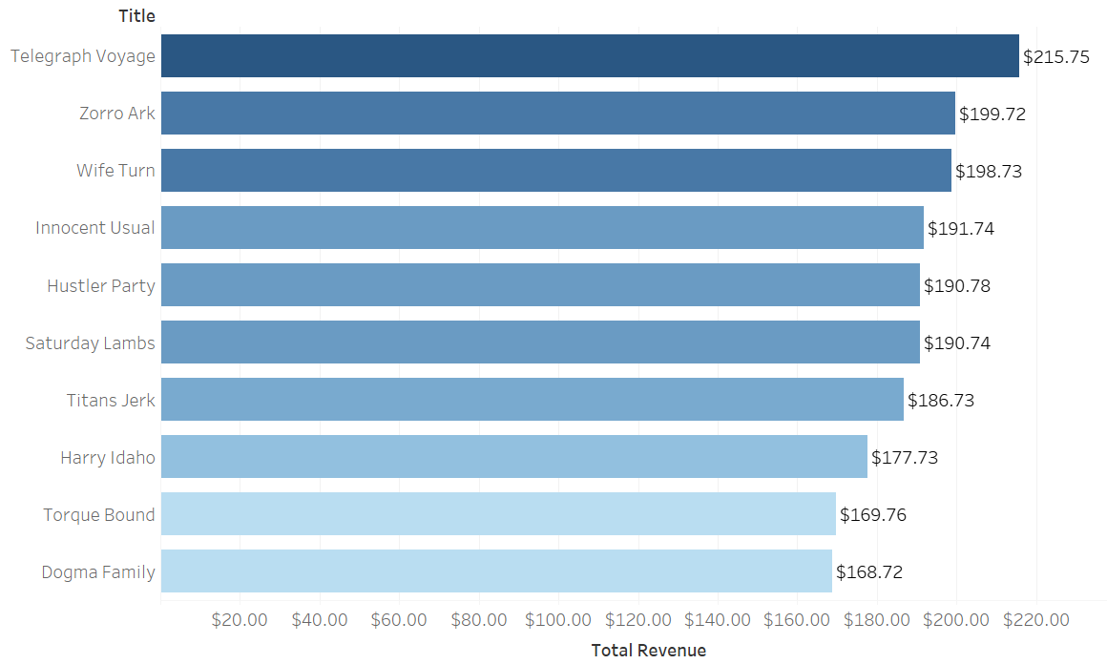
Top 10 Movies By Revenue:
Title Of The Movie | Revenue
1. Telegraph Voyage | $215.75
2. Zorro Ark | $199.72
3. Wife Turn | $198.73
4. Innocent Usual | $191.74
5. Hustler Party | $190.78
6. Saturday Lambs | $190.74
7. Titans Jerk | $186.73
8. Harry Idaho | $177.73
9. Torque Bound | $169.76
10. Dogma Family | $168.72

Slide 6
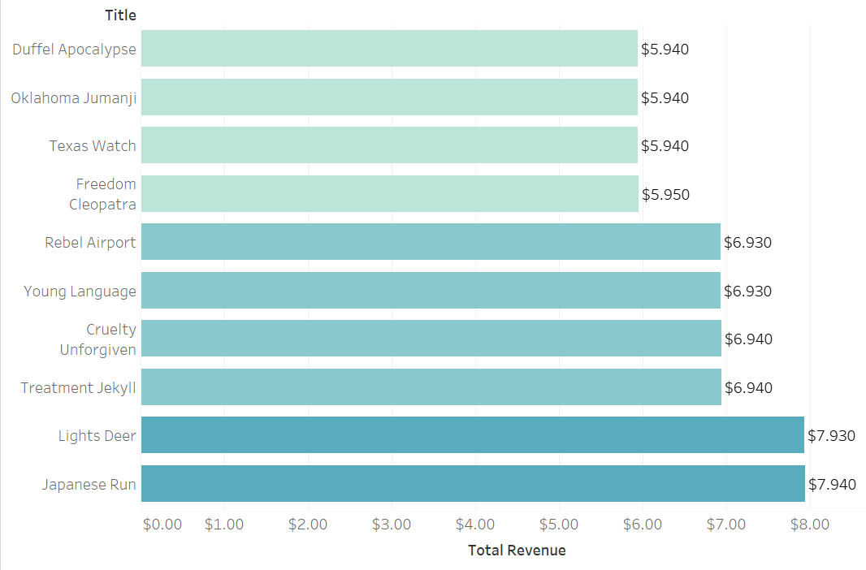
Bottom 10 Movies By Revenue
Title Of The Movie | Revenue
1.Duffel Apocalypse | $5.94
2.Oklahoma Jumanji | $5.94
3.Texas Watch | $5.94
4.Freedom Cleopatra | $5.95
5.Young Language | $6.93
6.Rebel Airport | $6.93
7.Treatment Jekyll | $6.94
8.Cruelty Unforgiven | $6.94
9.Lights Deer | $7.93
10.Japanese Run | $7.94

Slide 7
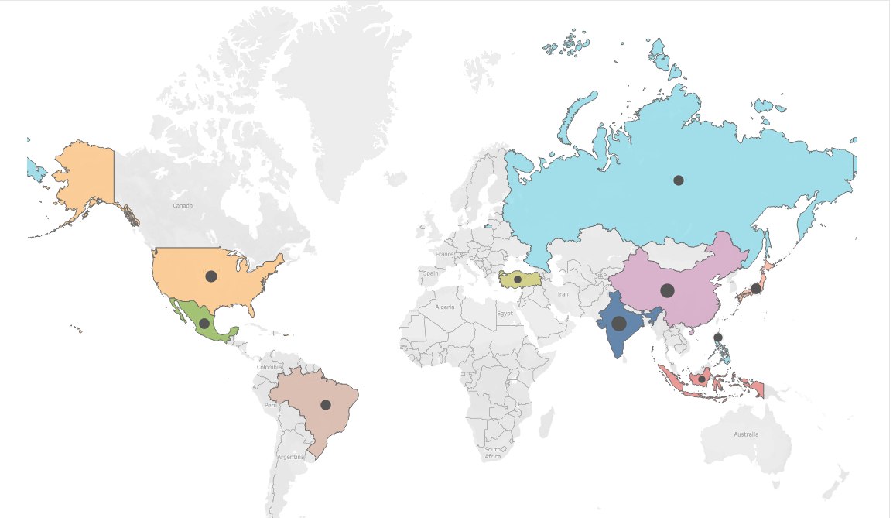
Top 10 Countries Based On Customers
Name Of The Countries | Number Of Customers
1.India | 60
2.China | 53
3.United States | 36
4.Japan | 31
5.Mexico | 30
6.Brazil | 28
7.Russian Federation | 28
8.Philippines | 20
9.Turkey | 15
10.Indonesia | 14

Slide 8
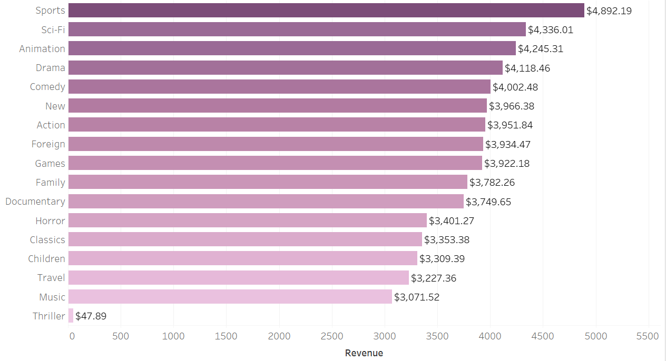
Genre By Revenue
Top 10 Genre | Revenue
1.Sports | $4,892.19
2.Sci-Fi | $4,336.01
3.Animation | $4,245.31
4.Drama | $4,118.46
5.Comedy | $4,002.48
6.New | $3,966.38
7.Action | $3,951.84
8.Foreign | $3,934.47
9.Games | $3,922.18
10.Family | $3,782.26

Slide 9
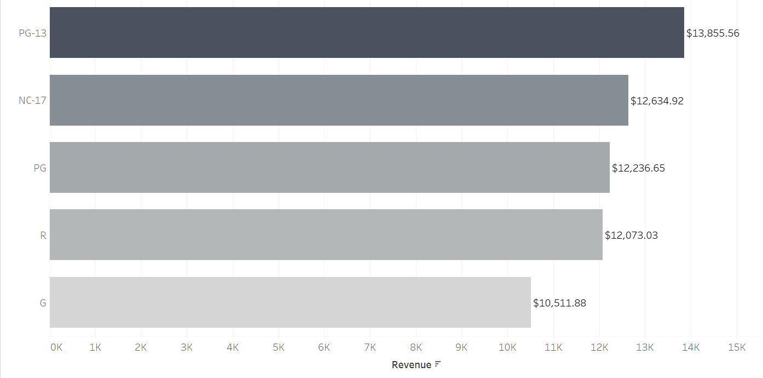
Rating By Revenue
Rating | Revenue
PG-13 | $13,855.56
NC-17 | $12,634.92
PG | $12,236.65
R | $12,073.03
G | $10,511.88

Slide 10
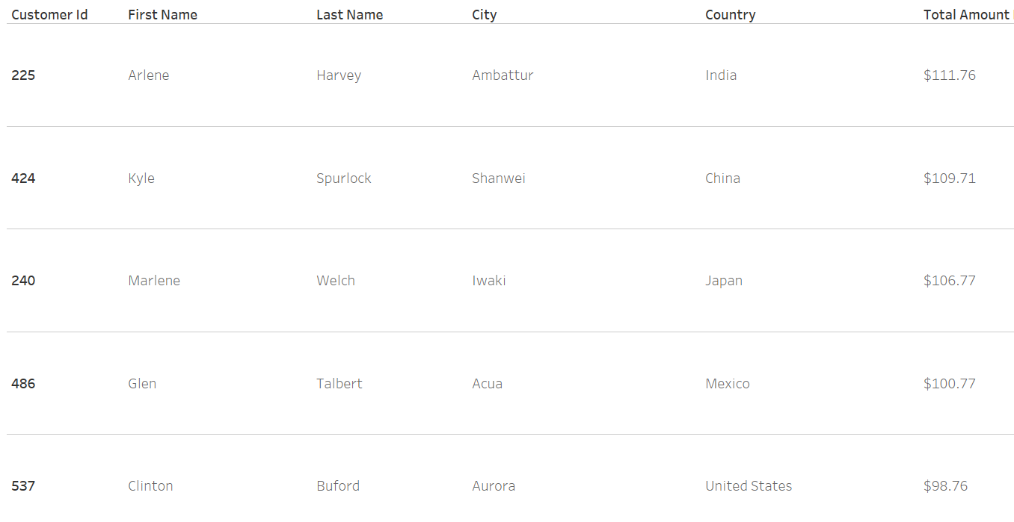
Top 5 Customers by City & Countries Who Paid The Most

Slide 11
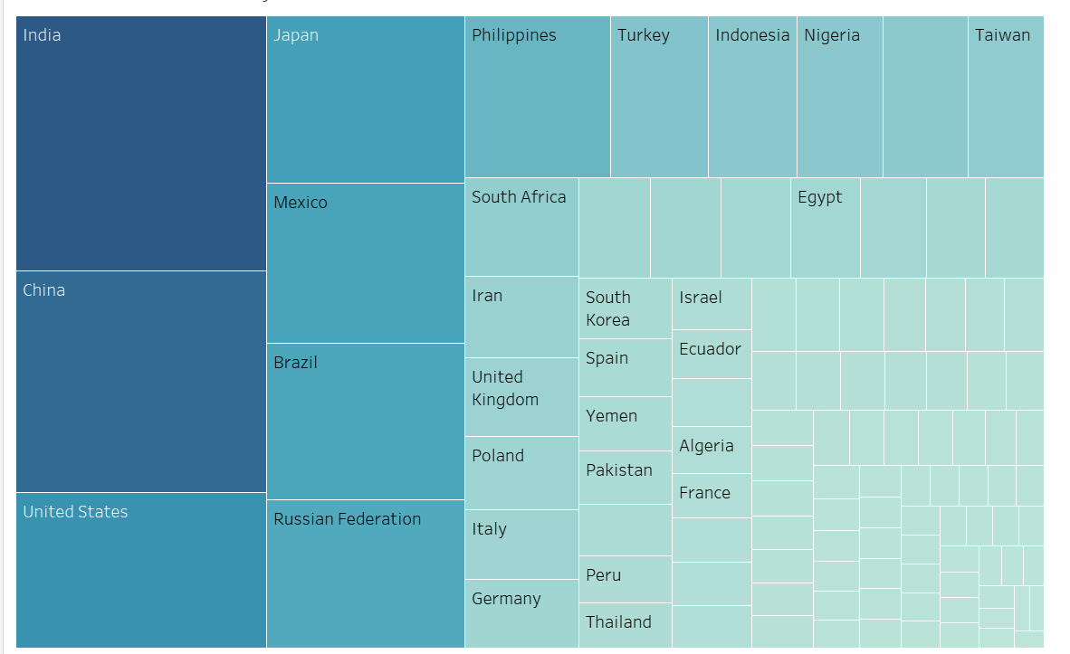
Countries Ranked By Revenue
Top 10 countries | Revenue
1.India | $6,032.79
2.China | $5,247.04
3.United States | $3,694.27
4.Japan | $3,121.52
5.Mexico | $2,984.82
6.Brazil | $2,919.19
7.Russian Federation | $2,765.62
8.Philippines | $2,219.70
9.Turkey | $1,498.49
10.Indonesia | $1,352.69

Slide 12
Conclusion and Recommendations
Conclusion:
There is a strong market for movies like Telegraph Voyage, Zorro Ark, and Wife Turn.
The movies like Duffel Apocalypse, Oklahoma Jumanji, and Texas Watch highlight areas for improvement in film selection and marketing strategy.
countries such as India, China, and the United States have the most customers. There are opportunities for targeted marketing and expansion into emerging markets like the Philippines and Indonesia.
There is a strong interest in genres like Sports, Sci-Fi, and Animation among the customers. PG-13 and NC-17, indicating a preference for these ratings among viewers tend to generate higher revenue.
Recommendation:
Focus on acquiring more movies in genres like sports, sci-fi, animation, drama, and comedy which have proven to be top revenue drivers.
Expand marketing efforts in countries with a high customer base like India, China, and the United States. consider localized marketing campaigns and content to cater to the preferences of these markets.
Consider implementing loyalty programs to reward frequent customers. Built trust with the customer base.
Continue to monitor revenue trends by genre, country, and rating to identify opportunities for revenue growth.

Slide 13
THANK YOU.
Questions?
Name: Madhvi Rathod.
Email Address: mdvrathod1130@gmail.com

